Slide 1
Offshore Wind Turbine Prototype
Tamara Roberson
Candidate for Associate Software Engineer

Slide 2

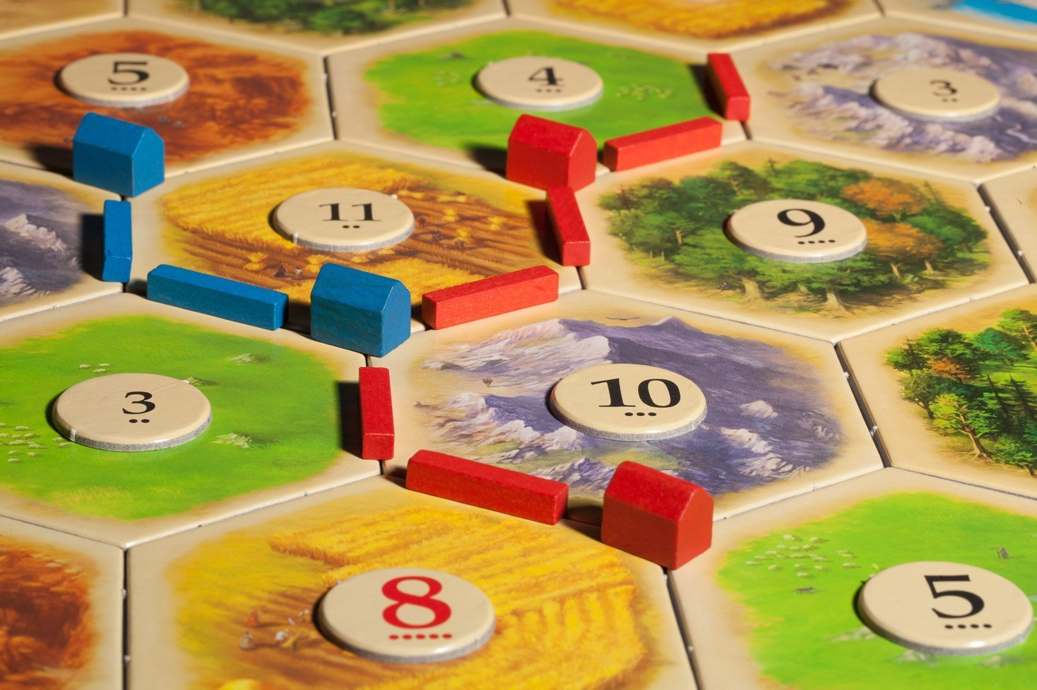
Who Am I?
Tamara Roberson
Graduating from WSU Everett with a BSEE this week
Starting a career in embedded software
Hobby: Board Games

Slide 3
Who Are You?
Name
Specialization
Not your job title
What are you the “go to” person for?
React? Analog ICs? LaTeX?
Hobby
Open-Source Software? Video Games? Hiking? Museums?

Slide 4
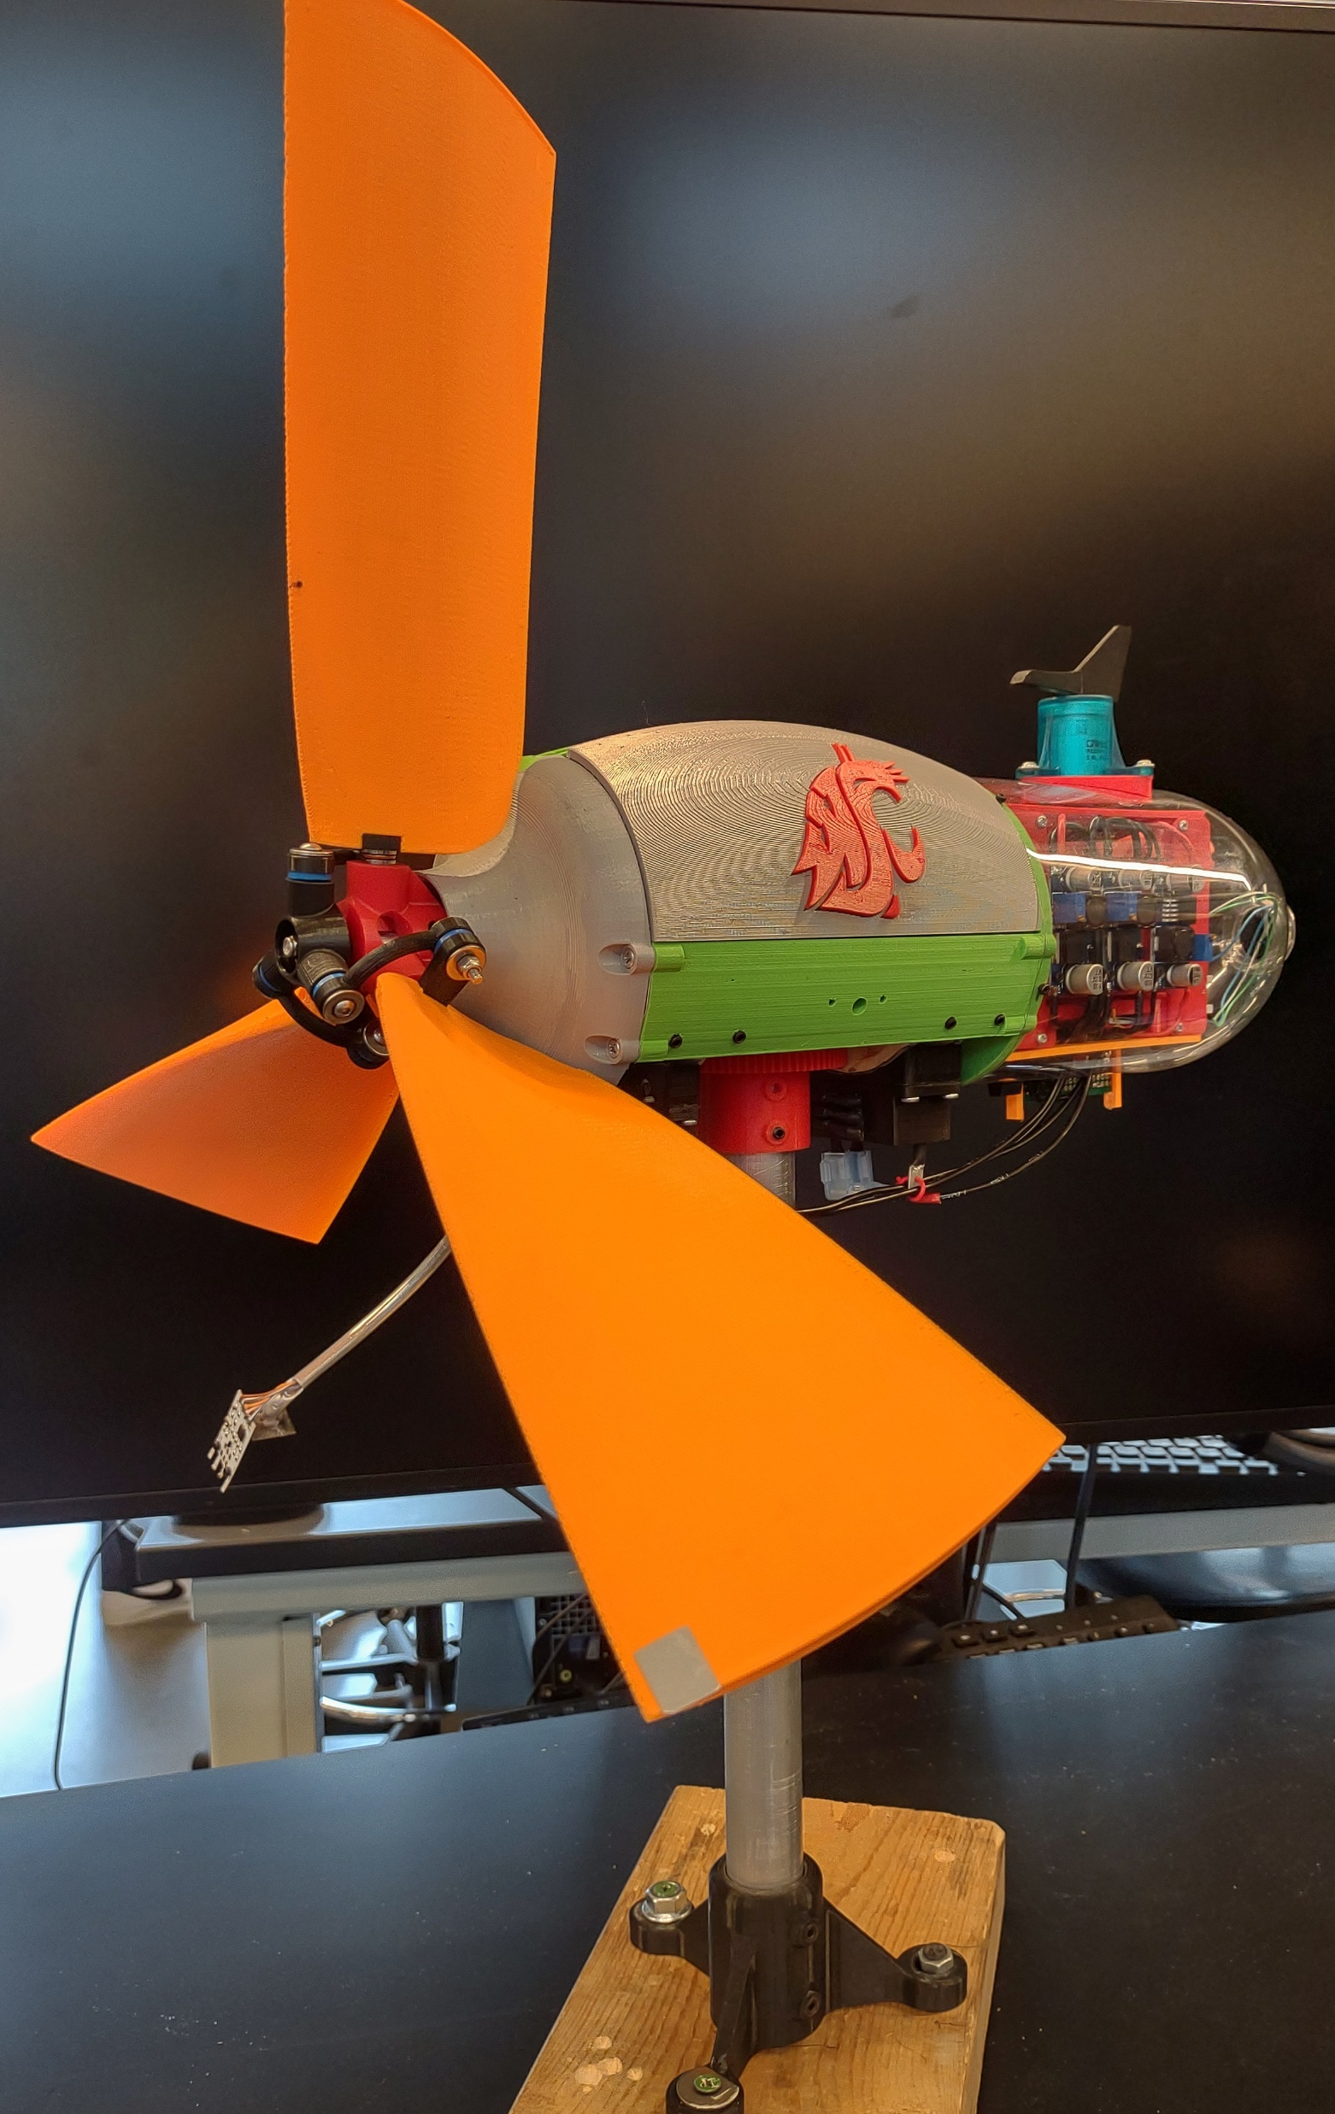
The Team
Senior Design Project and Engineering Club Team
US Department of Energy Collegiate Wind Competition
Team of 3 EEs, 1 ME
Club also includes several Business and Communications students for outreach and wind farm business analysis

Slide 5
Design Considerations
Collegiate Wind Competition rules
Offshore wind turbine designed to be installed in the Gulf of Mexico

